Slide 1
NLU Share——
Papers about Disfluency Detection
Shared by QuQin, 2017.02.20

Slide 2
Contents
01 What is disfluency detection
02 Current Studies
03 Enhancing Neural Disfluency Detection
with Hand-crafted Features
0 4 A Neural Attention Model
— * —

Slide 3
01 What is
02 Current Studies
03 Paper1
04 Paper2
A flight to Beijing Wuhan Tuesday
我们在正心楼，嗯，不，还是在主楼见面吧

Slide 4
01 What is
02 Current Studies
03 Paper1
04 Paper2
Disfluency of a sentence can be categorized into five classes (Wu et al., 2015)
Uncompleted words
Filled pauses (e.g. “uh”, “um”)
Editing terms (e.g. “you know”)
Discourse markers (e.g. “I mean”)
Repairs that are discarded, or corrected by its following words
Efficient disfluency detection with transition-based parsing
http://wing.comp.nus.edu.sg/~antho/P/P15/P15-1048.pdf

Slide 5

01 What is
02 Current Studies
03 Paper1
04 Paper2
disfluencies annotated in the style of (Shriberg, 1994)
FP=Filled Pause
RM=Reparandum ( 待修正语 )
IM=Interregnum
RP=Repair ( 修正语 )
Preliminaries to a theory of speech disfluencies
https://www.researchgate.net/publication/2325587_Preliminaries_to_a_Theory_of_Speech_Disfluencies

Slide 6
01 What is
02 Current Studies
03 Paper1
04 Paper2
Sequence tagging methods (Ferguson et al.,
2015; Georgila, 2009)
carefully designed features required
sparsity problem
cannot keep the generated sentences grammatical
Disfluency detection with a semi-markov model and prosodic features http://www.aclweb.org/website/old_anthology/N/N15/N15-1029.pdf
Using integer linear programming for detecting speech disfluencies
http://www.aclweb.org/anthology/N09-2028.pdf

Slide 7
01 What is
02 Current Studies
03 Paper1
04 Paper2
(2) syntax-based disfluency detection works
(Honnibal and Johnson, 2014; Wu et al., 2015)
data that both have syntax trees and disfluency annotations are scarce
performance of syntax parsing models hinders disfluency detection’s performance
Joint incremental disfluency detection and dependency parsing
http://acl2014.org/acl2014/Q14/pdf/Q1402.pdf

Slide 8
01 What is
02 Current Studies
03 Paper1
04 Paper2
(3) RNN classification method (Hough and Schlangen, 2015)
doesn’t model the transition between tags
cannot keep the generated sentences grammatical
Recurrent neural networks for incremental disfluency detection
http://www.isca-speech.org/archive/interspeech_2015/papers/i15_0849.pdf

Slide 9
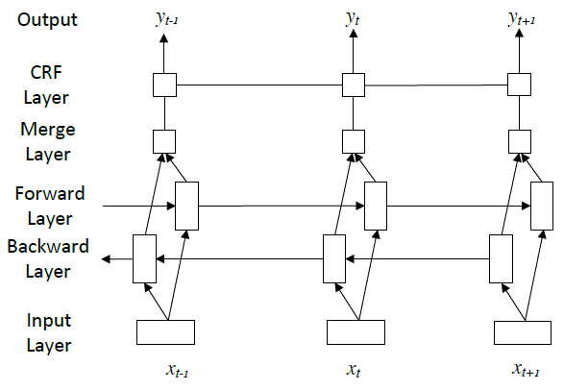
01 What is
02 Current Studies
03 Paper1
04 Paper2
Enhancing Neural Disfluency Detection with
Hand-crafted Features
=> Model Description
BI-LSTM-CRF

Slide 10
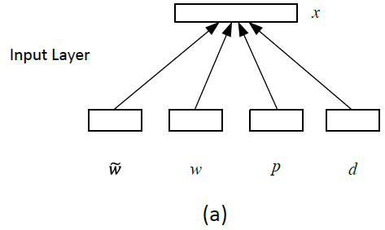
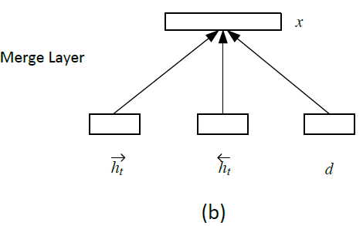
01 What is
02 Current Studies
03 Paper1
04 Paper2
Enhancing Neural Disfluency Detection with Hand-crafted Features
=> Input Representation
w: a learned word embedding
: a pretrained word embedding
p: a learned POS-tag embedding
d: a hand-crafted feature representation

Slide 11
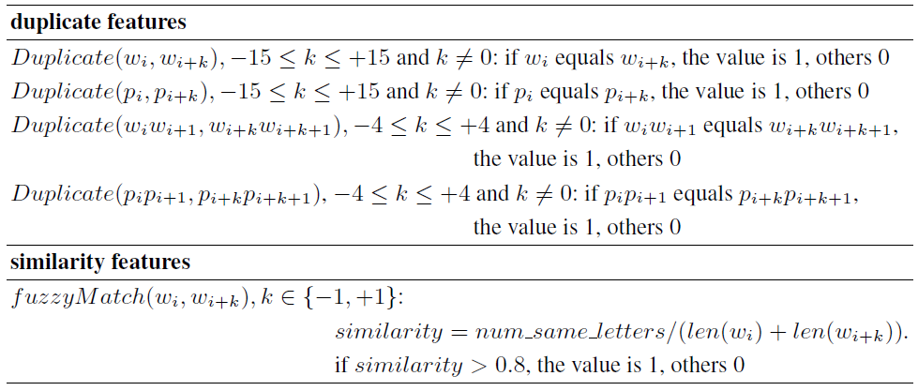
01 What is
02 Current Studies
03 Paper1
04 Paper2
Enhancing Neural Disfluency Detection with
Hand-crafted Features
=> Hand-crafted Features

Slide 12
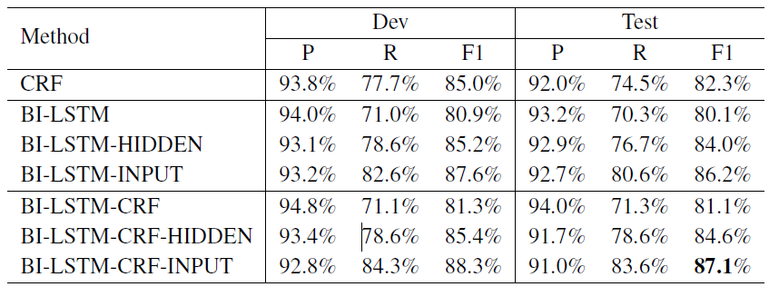
01 What is
02 Current Studies
03 Paper1
04 Paper2
Enhancing Neural Disfluency Detection with
Hand-crafted Features
=> Effect of Hand-crafted Features

Slide 13
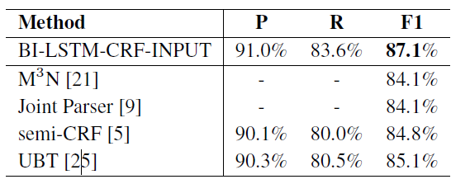
01 What is
02 Current Studies
03 Paper1
04 Paper2
Enhancing Neural Disfluency Detection with
Hand-crafted Features
=> Model Performance
Comparison of the BI-LSTM-CRF model with the previous methods on the test set of English Switchboard data

Slide 14
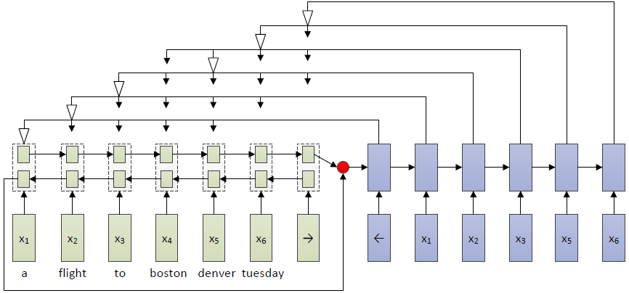
01 What is
02 Current Studies
03 Paper1
04 Paper2
A Neural Attention Model for Disfluency Detection
=> Model Description
BI-LSTM-based RNN
Attention-based Decoder

Slide 15
01 What is
02 Current Studies
03 Paper1
04 Paper2
A Neural Attention Model for Disfluency Detection
=> Input Representation
w: a learned word embedding
: a pretrained word embedding
p: a learned POS-tag embedding
d: a hand-crafted feature representation

Slide 16
01 What is
02 Current Studies
03 Paper1
04 Paper2
A Neural Attention Model for Disfluency Detection
=> Attention-based Decoder
select a word from the candidate words (x_{i}, ...x_{j}) rather than on a fixed output dictionary
once a word x_{k} is selected, all the words (x_{i}, ..., x_{k−1}) will be deleted and the candidate words in the next step will be (x_{k+1}, ...x_{l})

Slide 17

01 What is
02 Current Studies
03 Paper1
04 Paper2
A Neural Attention Model for Disfluency Detection
=> Attention-based Decoder
s_{t−1} is the decoder hidden states for time t − 1
v, W₁, W₂, and W₃ are learnable parameters of the model
d_{k−i} is the embedding distance between word x_{i−1} and the word x_{k}

Slide 18
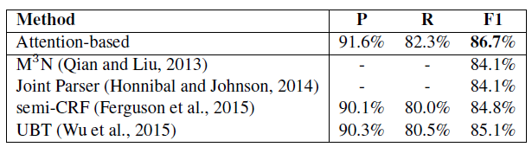
01 What is
02 Current Studies
03 Paper1
04 Paper2
A Neural Attention Model for Disfluency Detection
=> Model Performance
Comparison of the neural attention-based model with the previous methods on the test set of English Switchboard data

Slide 19
Thank You

